Slide 1








Application
Sakkiny
Rent property

Slide 2



team members
Eslam Ayman Zaky
Mahmoud abdallah metwally
Abdulrahman Mohammed Abdullah
Abdulrahman Rajab Muhammad

Slide 3





Agenda
Problem
Motivation
Objectives
Similar Application
Planning
Analysis
Implementation
Thank You

Slide 4




Problem

Slide 5

Problem
•In today's world, many people lead dynamic lives, requiring frequent searches for temporary accommodation that meets their needs.
•Whether college students seeking accommodation near campus, employees on business trips, or workers needing temporary housing during short-term assignments.
•By utilizing the Sakkiny app, individuals can streamline their lives and minimize the time and effort spent searching for appropriate accommodation
•It offers users a unique experience, allowing them to easily select accommodations that suit their needs through the various features and services provided within the app

Slide 6
Objectives

Slide 7



1
3
5
easy-to-use application for students, workers and other people to search for accommodation suited to their needs
Providing a service to tenants through which they can request maintenance services directly from the app
2
Enabling users to provide real estate ratings
4
Send immediate notifications when new properties conform to researchers' requirements.
have a database containing reliable information about the apartments offered and the landlords

Slide 8
Similar Application

Slide 9







Slide 10
Implementation

Slide 11

Technical Tools
Flutter package
API TOOLS
programming languages

Slide 12
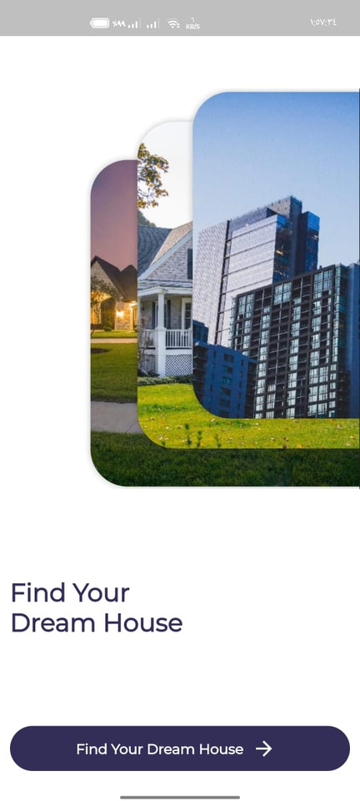
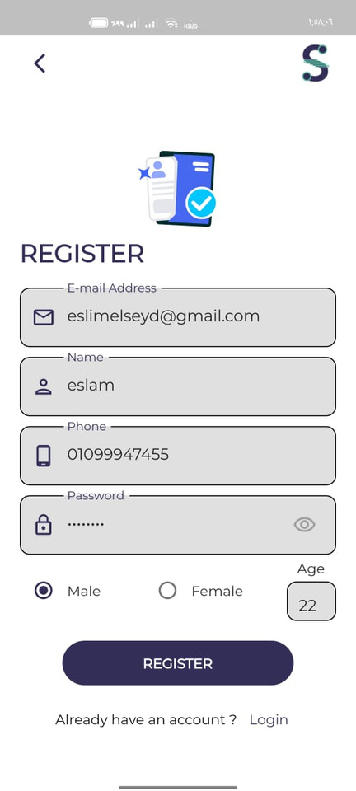
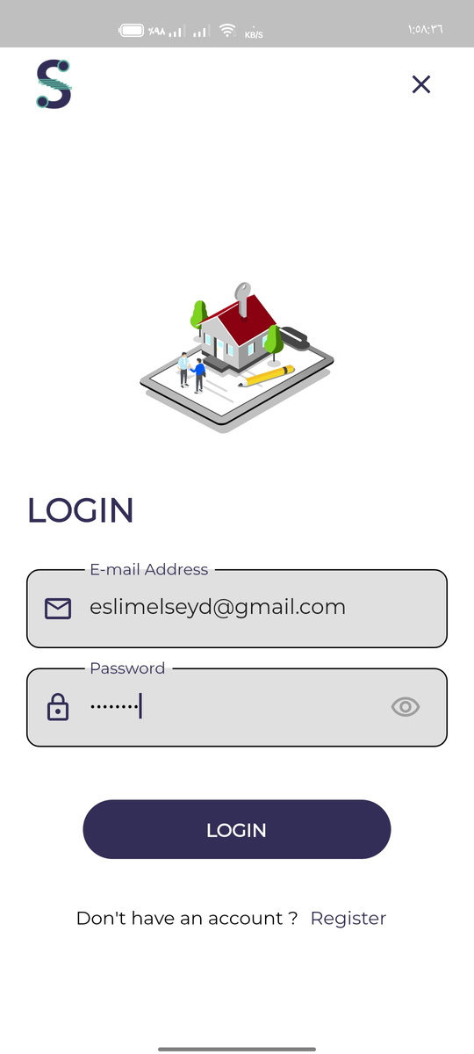
Design States

Slide 13
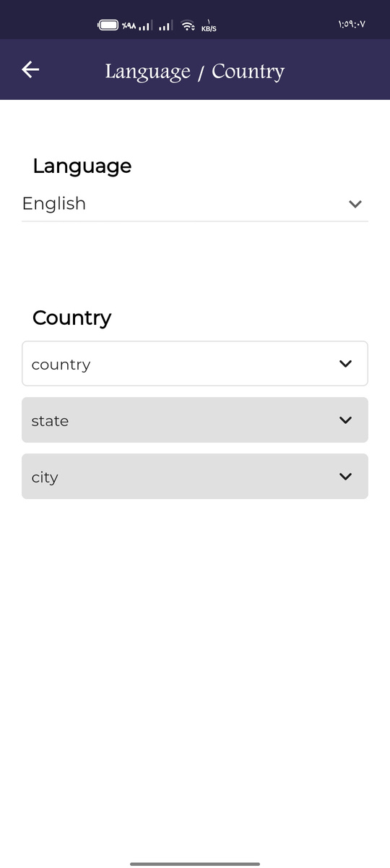
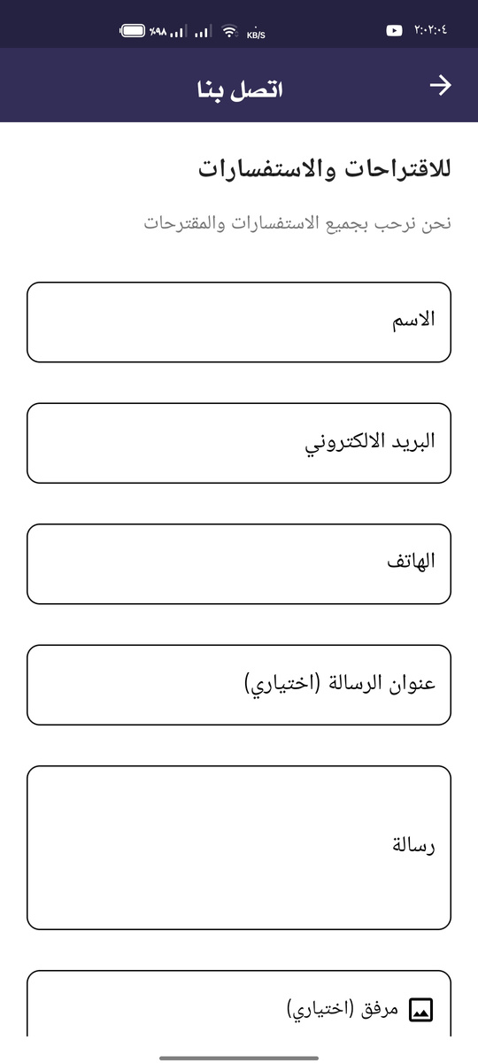
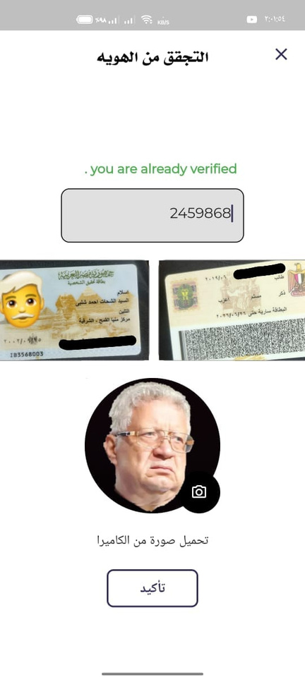
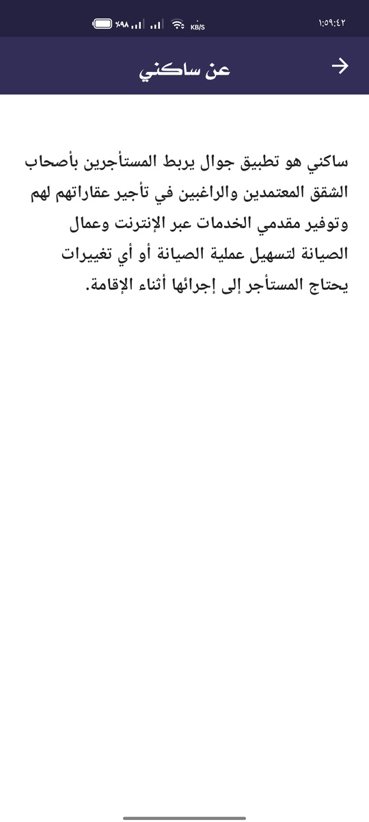
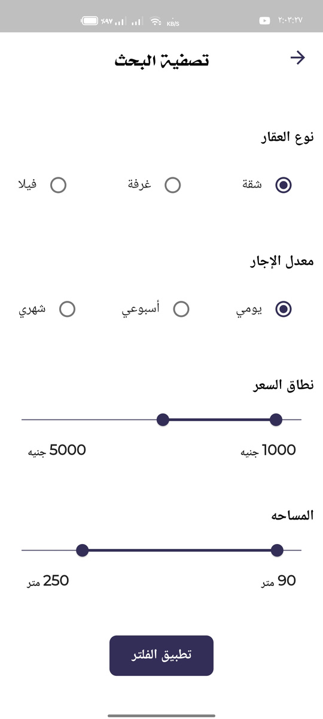
Design States

Slide 14
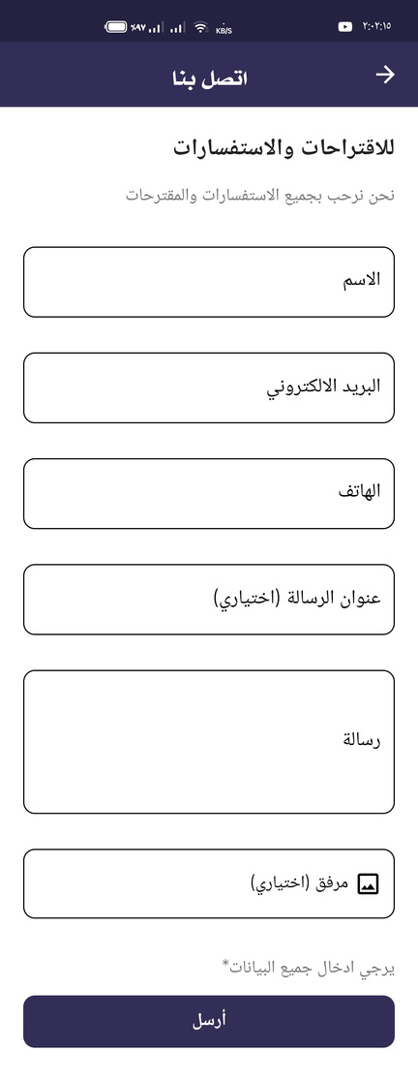
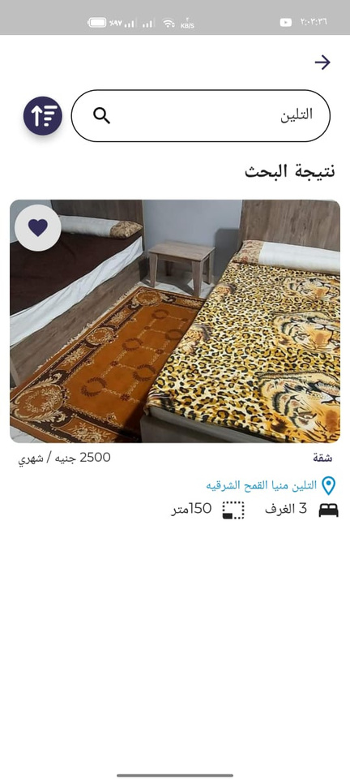
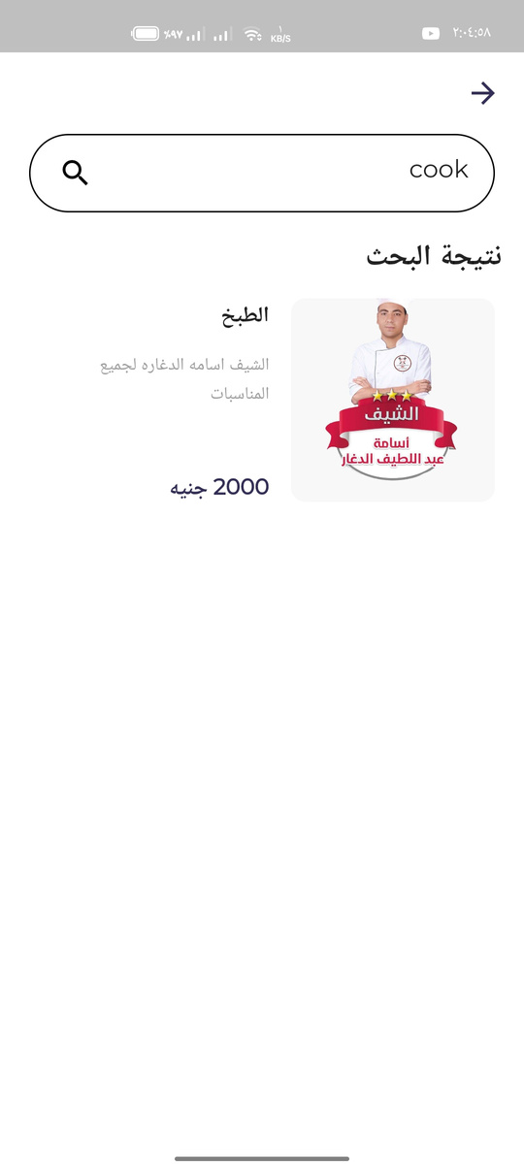
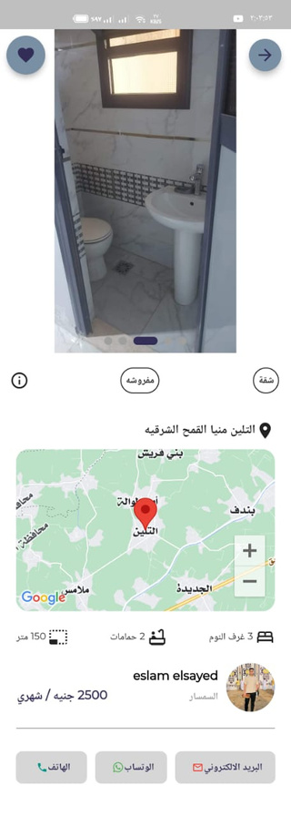
Design States

Slide 15
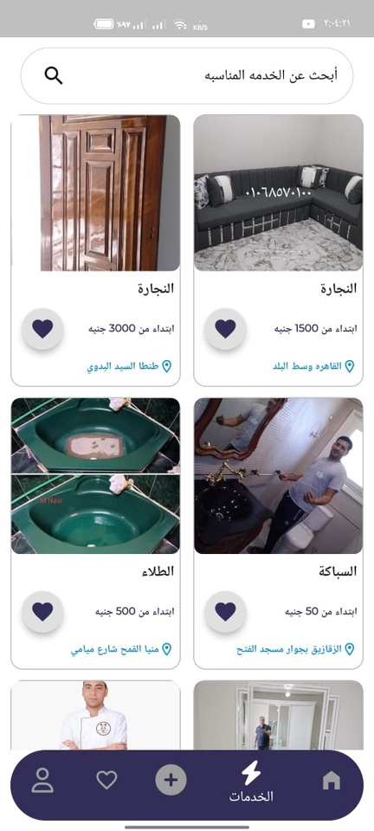
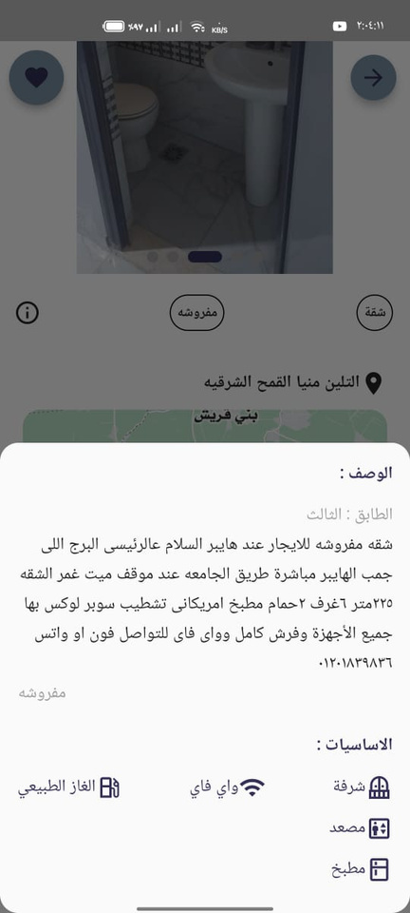
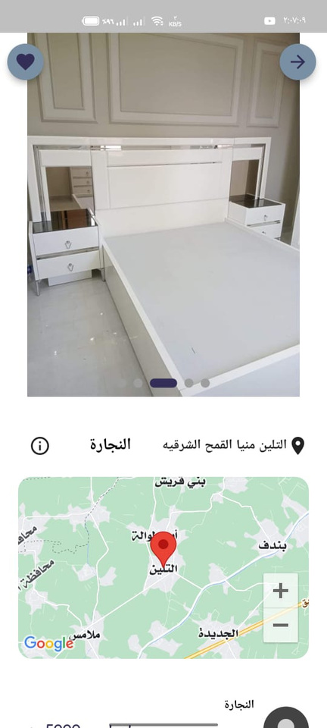
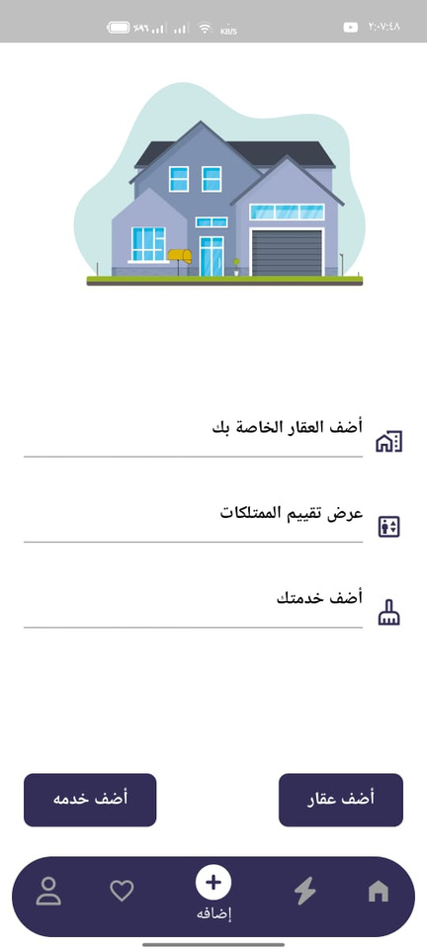
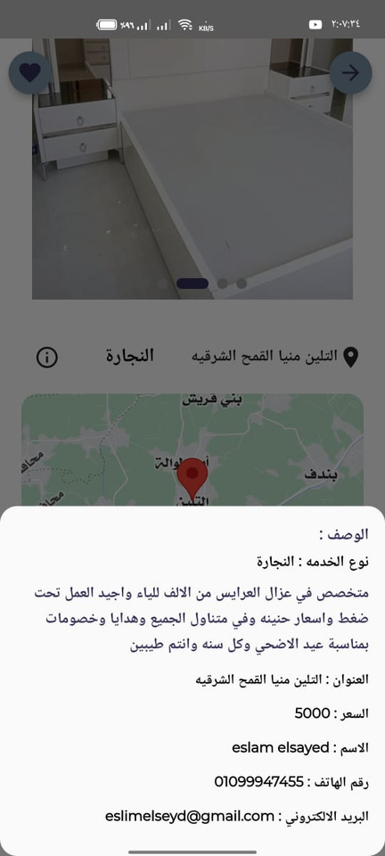
Design States

Slide 16
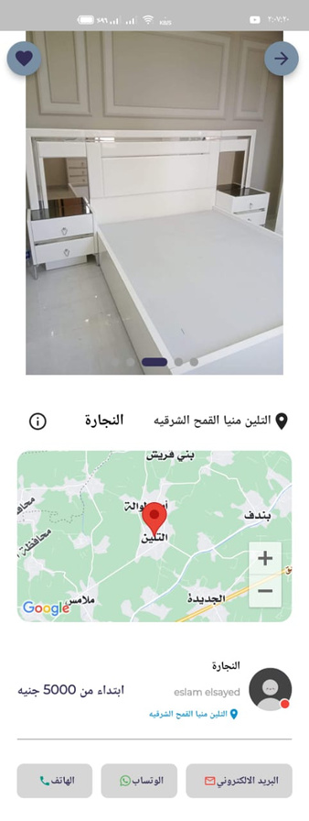
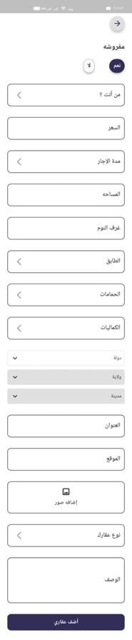

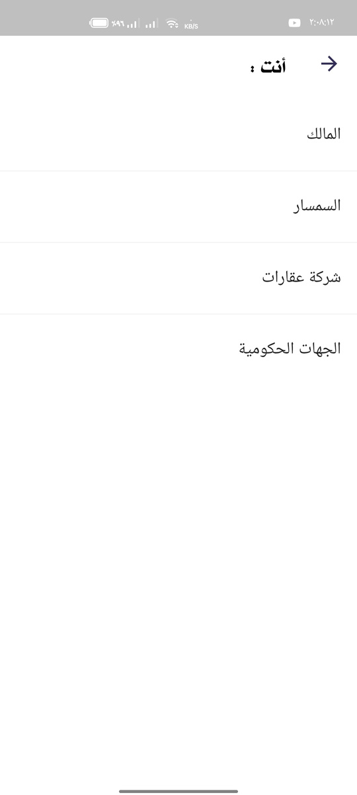
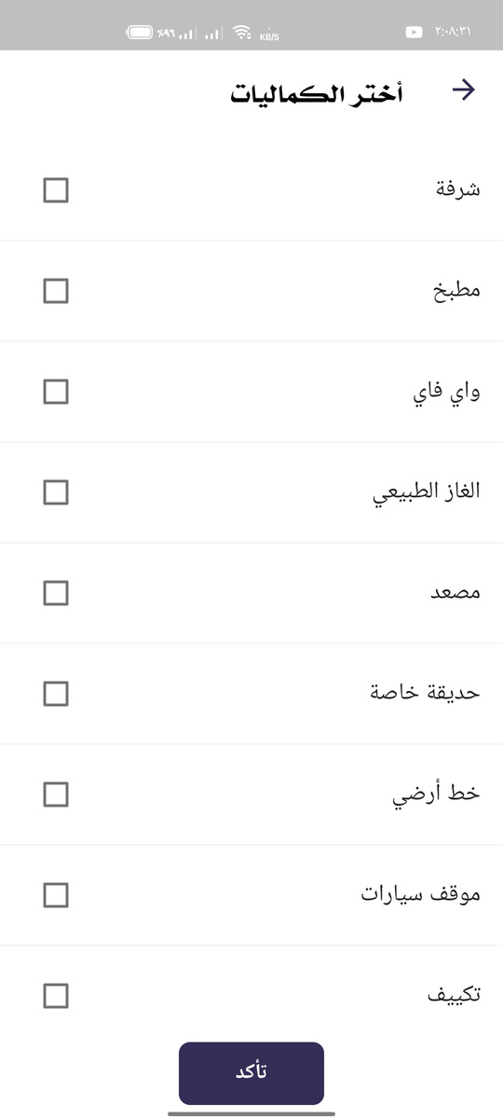
Design States

Slide 17
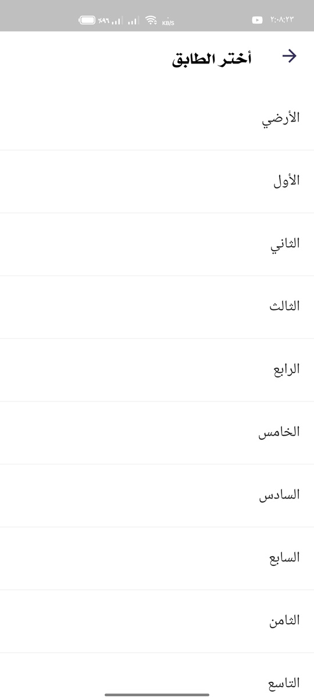
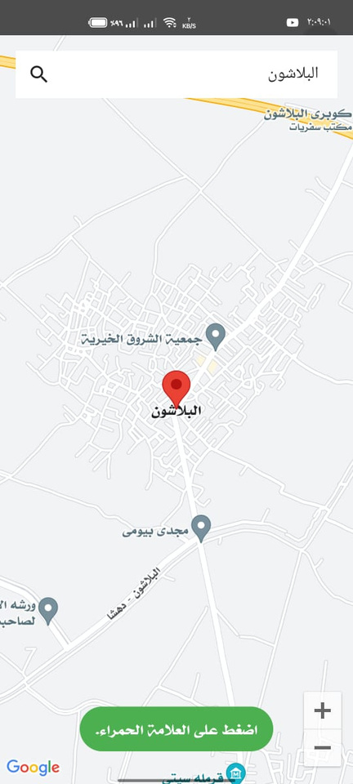
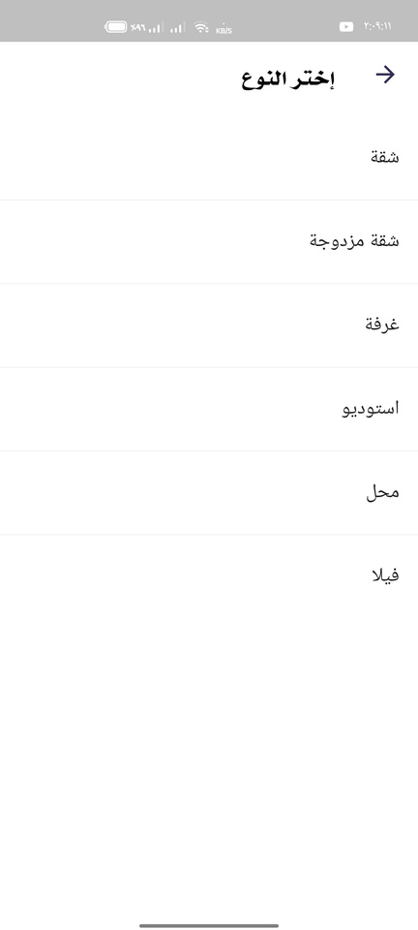
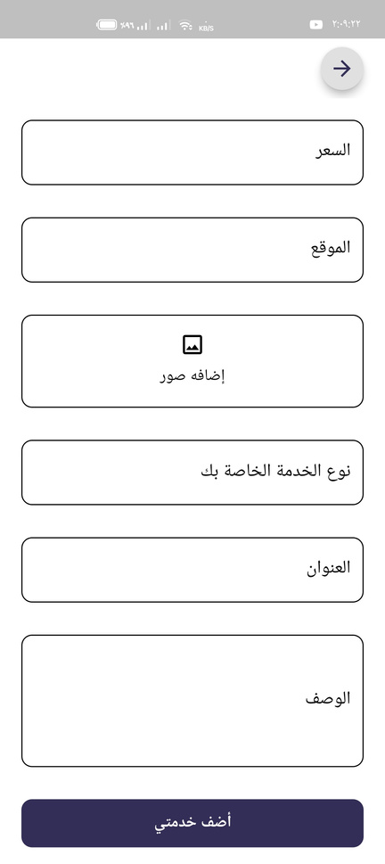
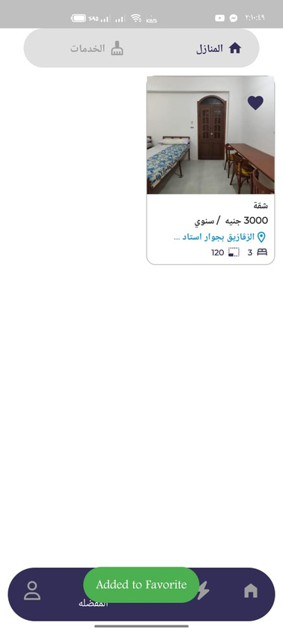
Design States

Slide 18
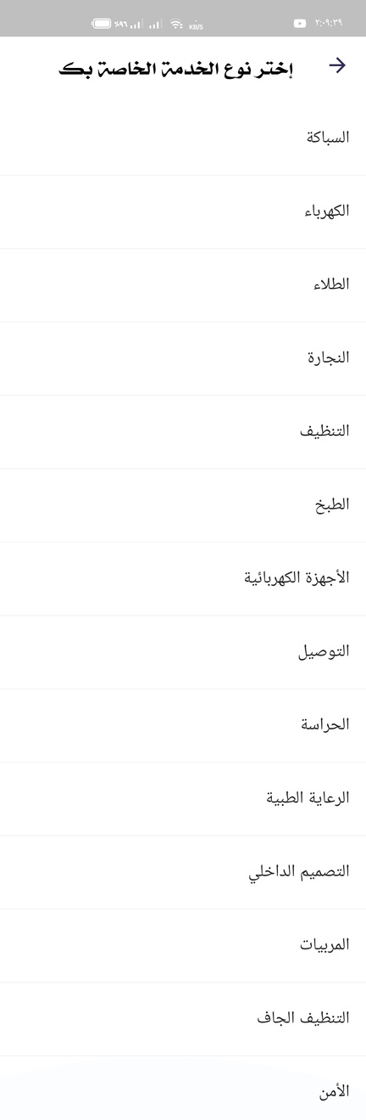
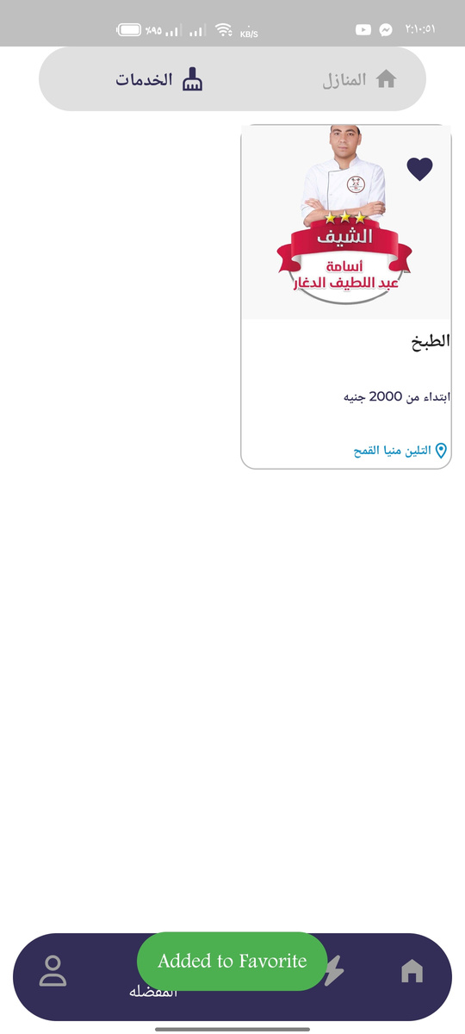

Design States

Slide 19
Flutter code

Slide 20
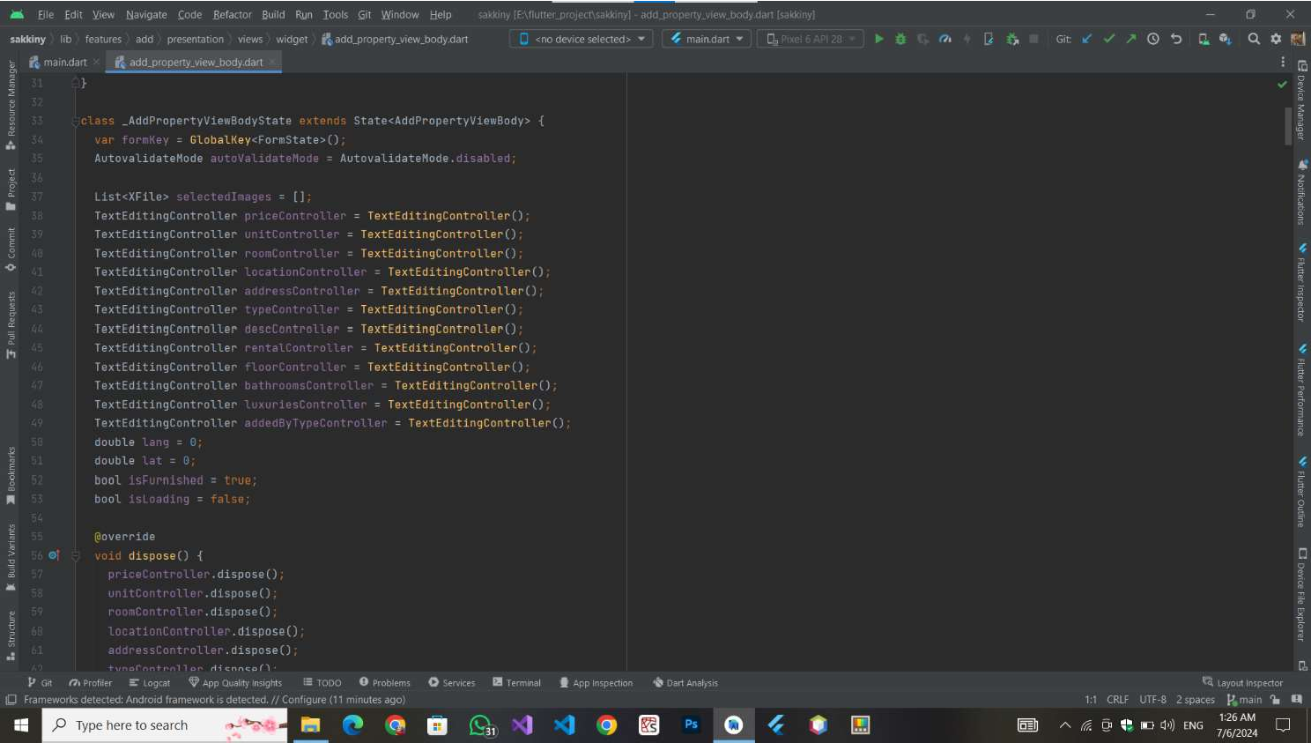





Slide 21
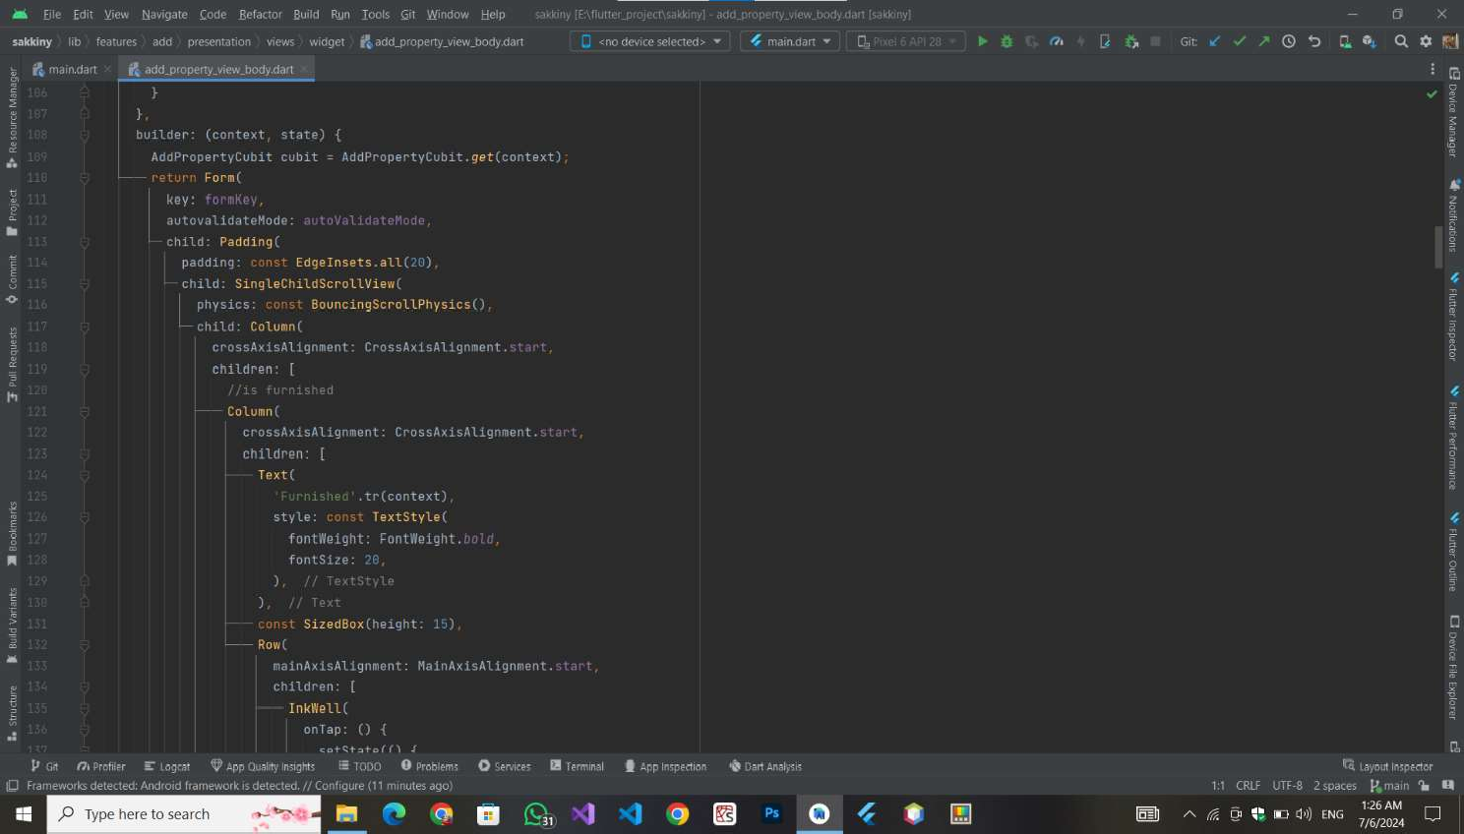

Slide 22
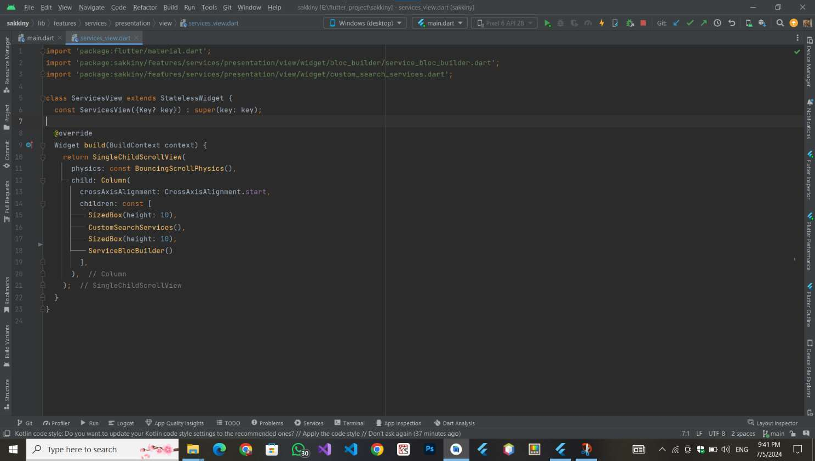
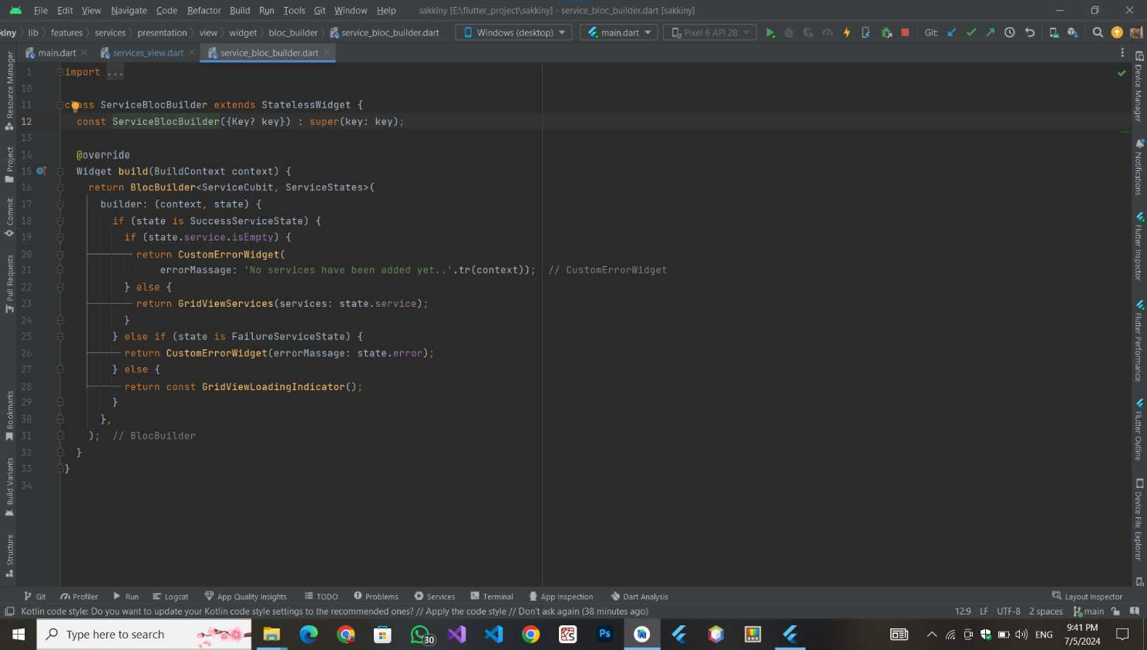

Slide 23

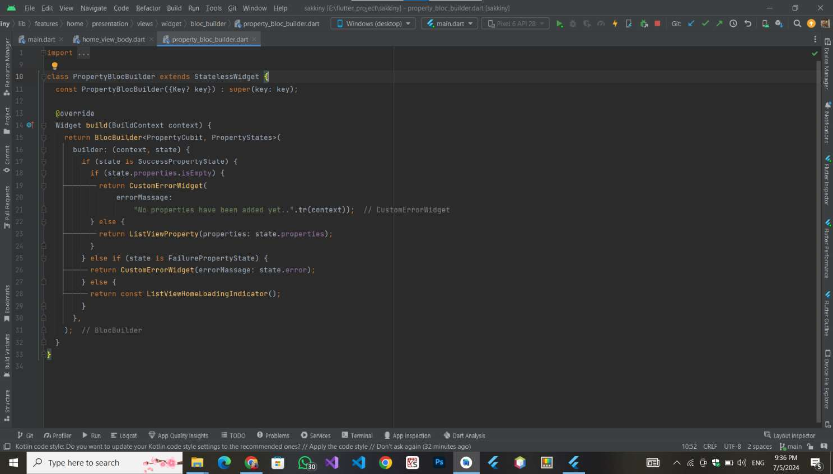

Slide 24
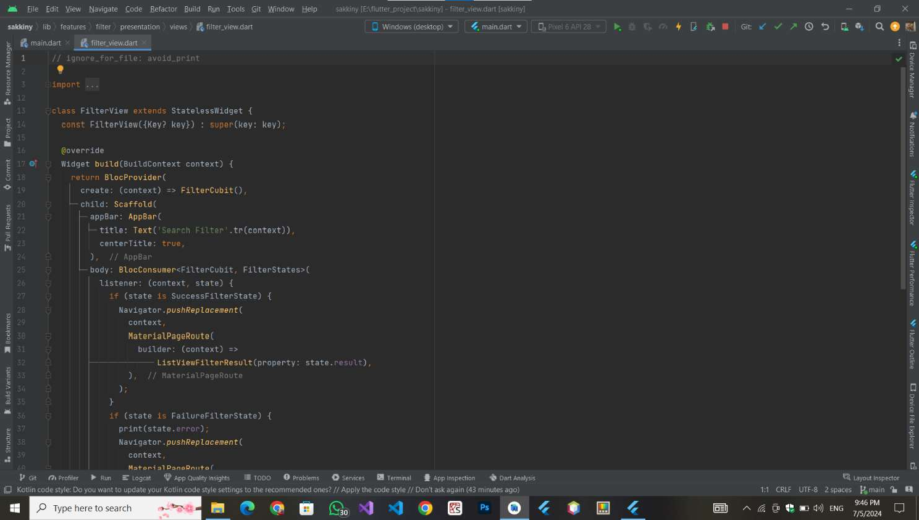
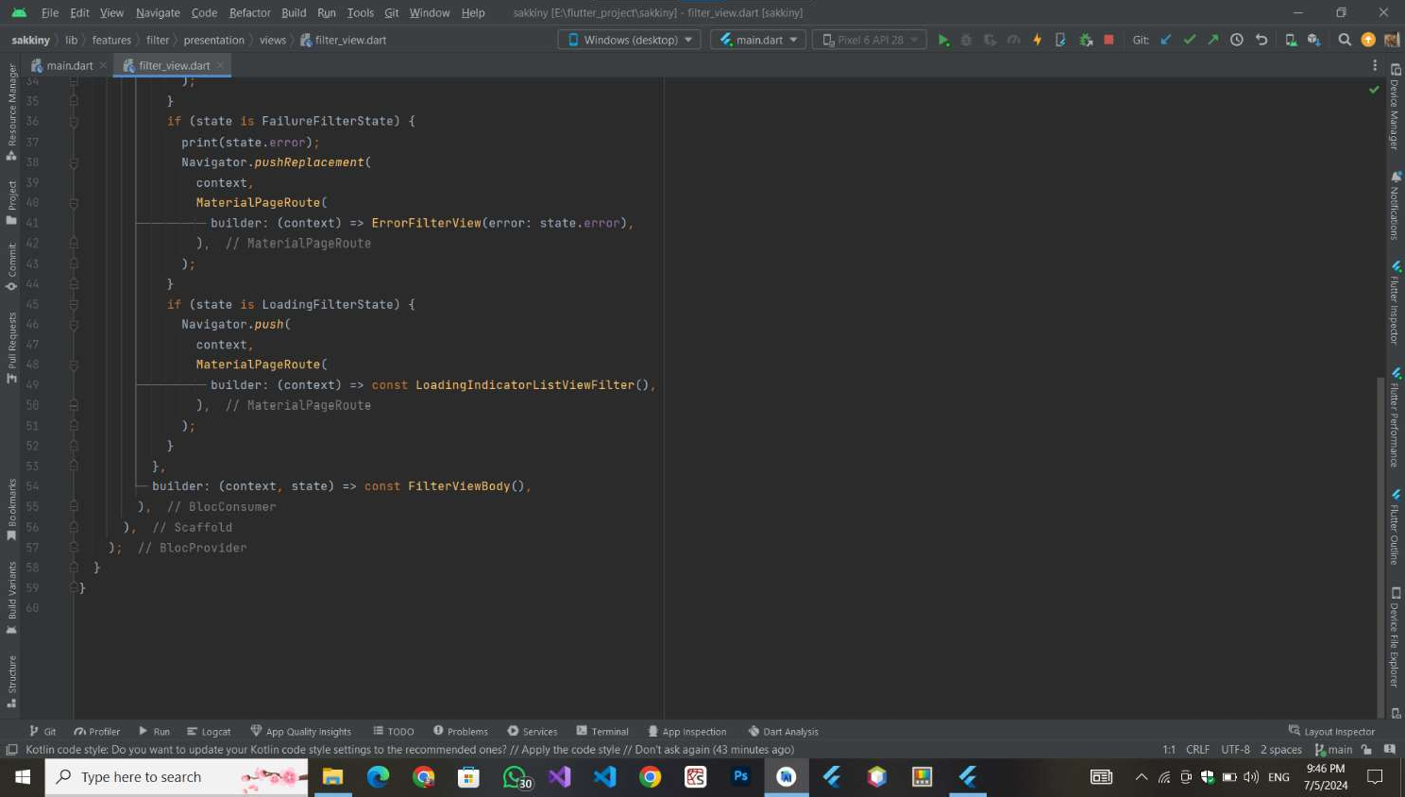

Slide 25
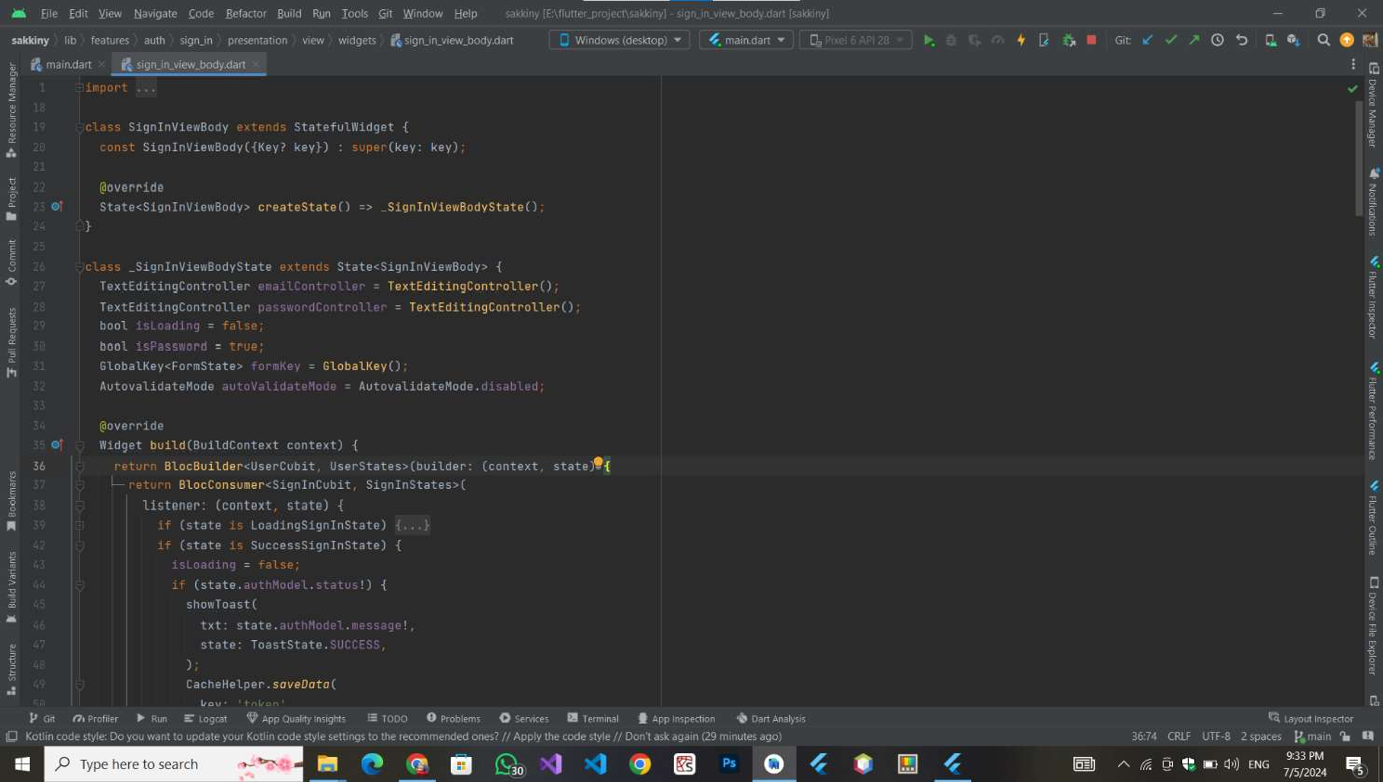
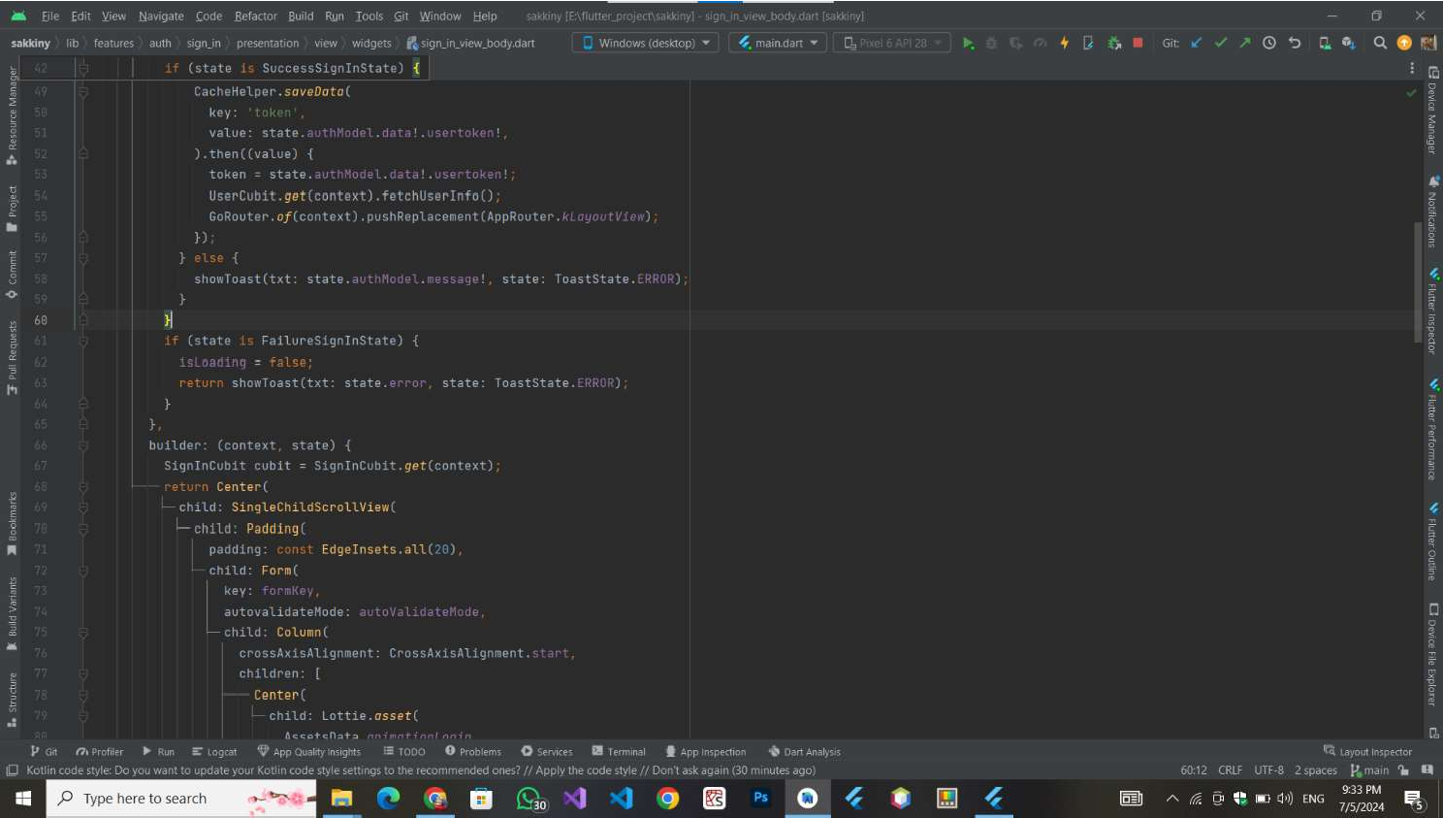

Slide 26
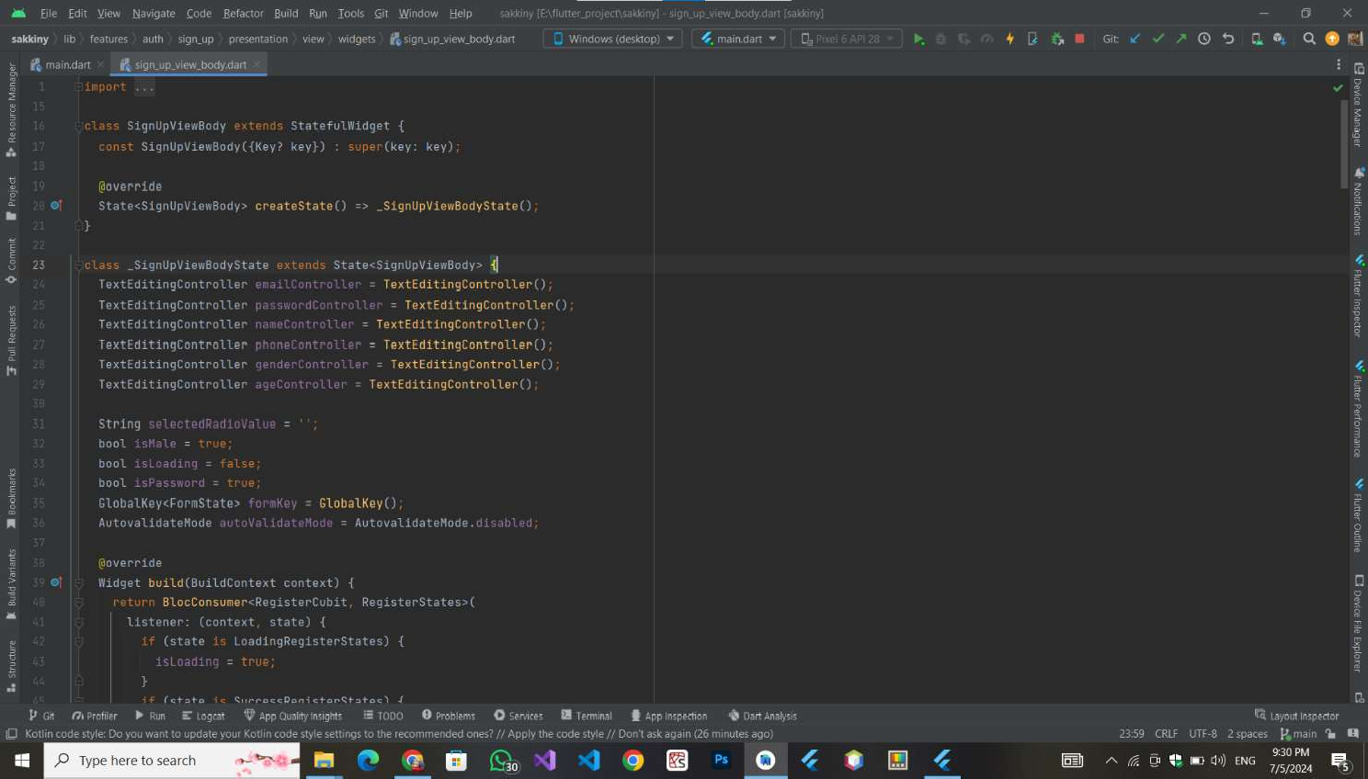
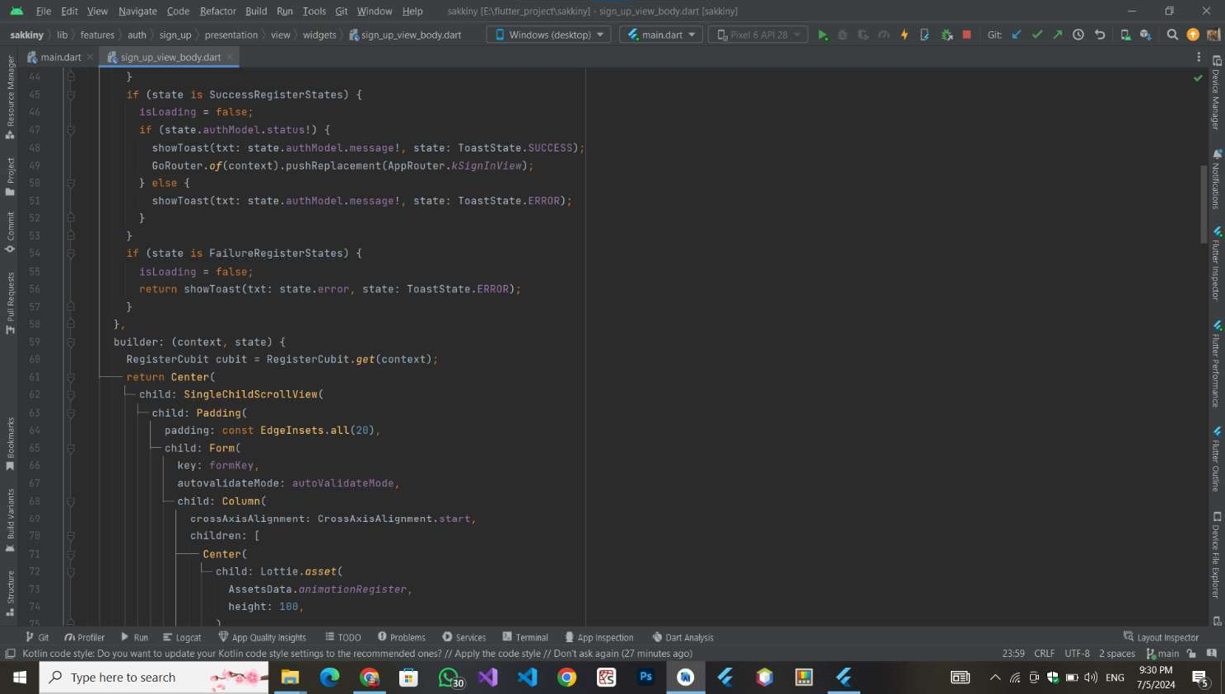

Slide 27
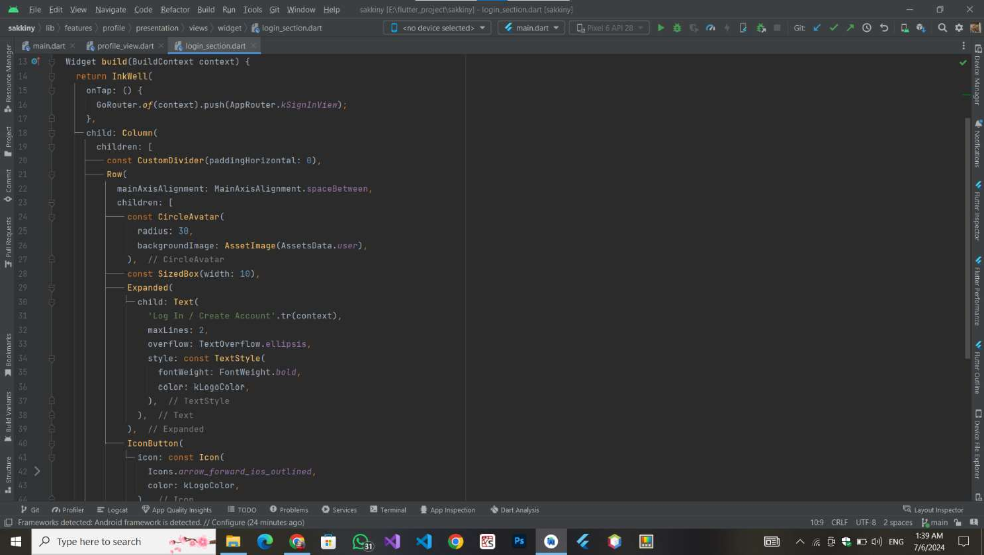
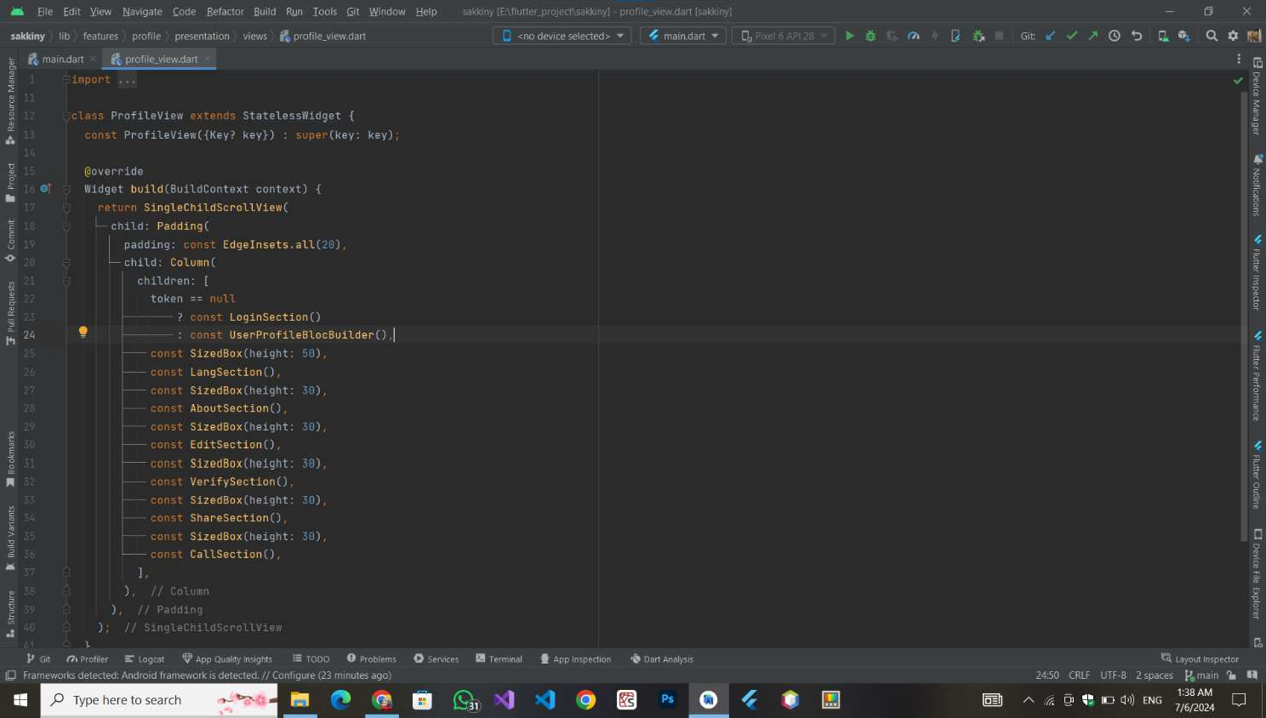

Slide 28



THANK YOU

